Slide 1

Automation of Invoice Reporting with UiPath
Kunal Gaurav
AI Automation | Project 6

Slide 2
Problem
The finance manager of a company manually checks each invoice sent to the company, copies the invoice number, supplier name, due date and the total amount due into a spreadsheet. Then the manager adds a new column consisting of a short note describing the purchase.
This process is manual and time consuming. It needs to be automated with the help of an AI Automated Workflow.
The task is to read 6 invoices (which have a due date of 09/22/2025 or before), extract all the relevant data from them and add the data to the spreadsheet columns. Then use AI to read and add the purchase description into the last column.
The task will be automated using UiPath studio.

Slide 3
Solution
The RPA workflow built on UiPath Studio iterates through all the invoices copied over at a specified location using the “For Each” module.
Relevant data - Invoice number, Supplier name, Due date and Total amount are extracted from the invoices using “Extract Document Data” module that is using the Predefined Document Understanding Project’s “Invoices” Extractor
An “If-else” module is used to select only those Invoices that have a due date on or before September 22, 2025.
Then, a nested “If-else” module is used to choose only those invoices whose confidence levels are >= 0.7. From a visual inspection ,there are 4 invoices that meet both this criteria and the criteria listed above.

Slide 4
Solution (contd.)
Now, a “Content Generation” AI module is used to read the invoice data and come up with a short purchase description of the invoice. This AI module uses gpt-5.1 model. The prompt used by the Content Generation Module is “You are helping a finance manager understand invoices.Look at the invoice text and generate a very short description (max 15 words) of what the company is purchasing.Keep it plain and businesslike.”
A “Write Row” module is used to open a pre-defined google sheet and update 5 columns- “Invoice number”, “Supplier name”, “Due date”, “Total amount” and “Purchase description”.

Slide 5
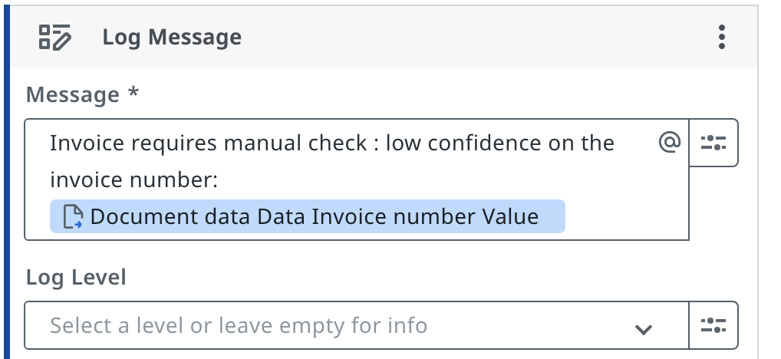
Solution (contd.)
Another nested “Else” module is added for the condition that Invoice number confidence is < 0.7. It logs an error saying that “Invoice requires manual check: low confidence on the invoice number.”
Below is the snapshot of the log module that is added to the workflow

Slide 6
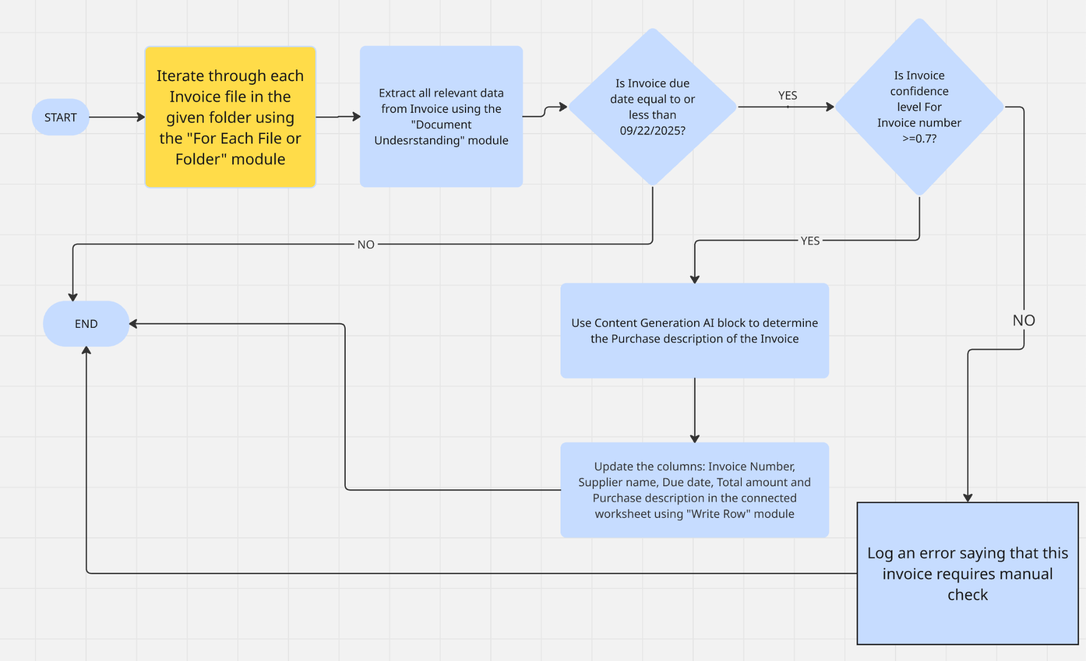
RPA Workflow Diagram
Link to the flowchart: https://miro.com/app/board/uXjVHFLz1s8=/?share_link_id=608143372628

Slide 7
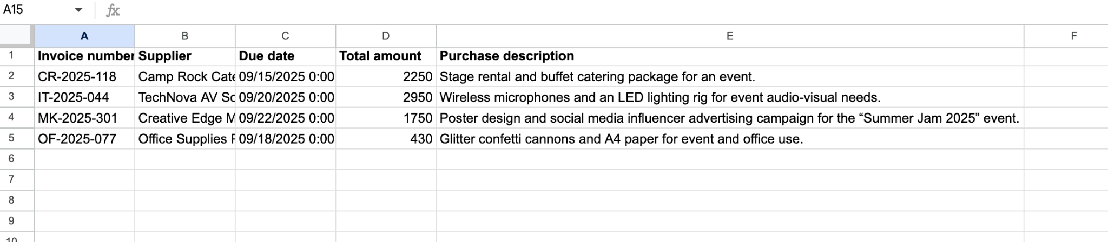
Link to Worksheet updated: https://docs.google.com/spreadsheets/d/1h-7Za3b6KcEFIz6D08tPMivzpXTuoM9zeTp1nYcQkN0/edit?usp=sharing
Snapshot of the worksheet is below:

Slide 8
Benefits of the Workflow
The workflow automates the task of strictly checking invoices for the date of Sept 22, 2025 or before. This process is seamless and error free
The workflow flags the unreadable invoices for human inspection. This task enhances the logic
There is a lot of time saved because human effort for this task is zero. The manager can focus on more important tasks

Slide 9
Improvements to the workflow
The error logs for this workflow could be enhanced with more information about why the some invoices are unreadable.
Some more information can be added to the Purchase description for the Invoices. The current max word limit of 15 words for the workflow can be increased.

